Slide 1
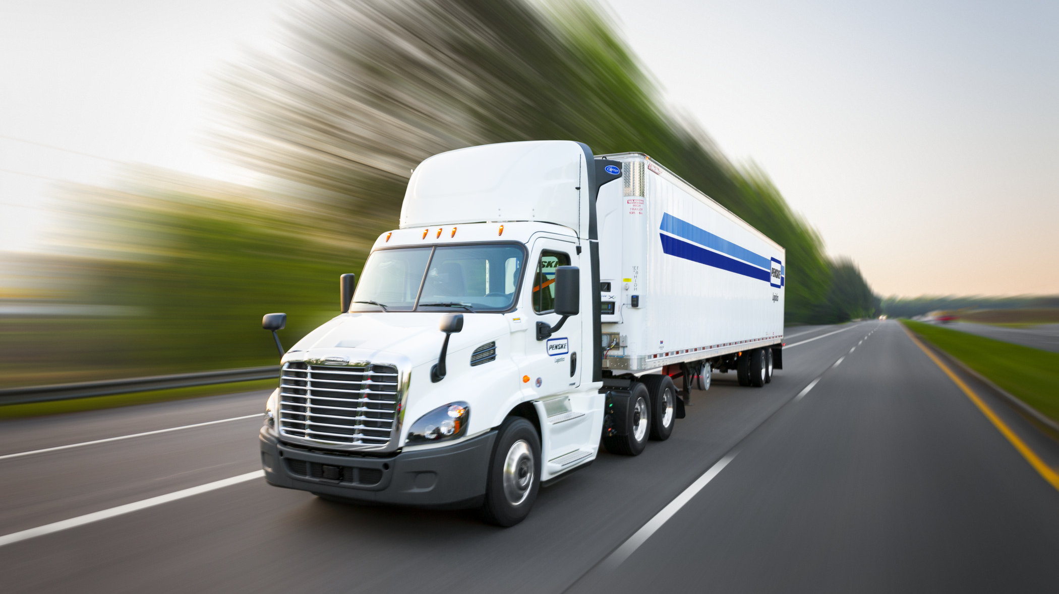
Az National Trucking Risk Analysis Prof. Rami El-Youssef Group 5
Kavya Prakash Hathwar, Bindu Musham, Shubham Dharmendra Tripathi, Srinikethan Pusthay, Prachi Gaur, Kevin Vinod Chauhan

Slide 2

Objective
Identifying dangerous truck drivers to meet organizational goal to better understand risk

Slide 3

Data Process Flow

Slide 4
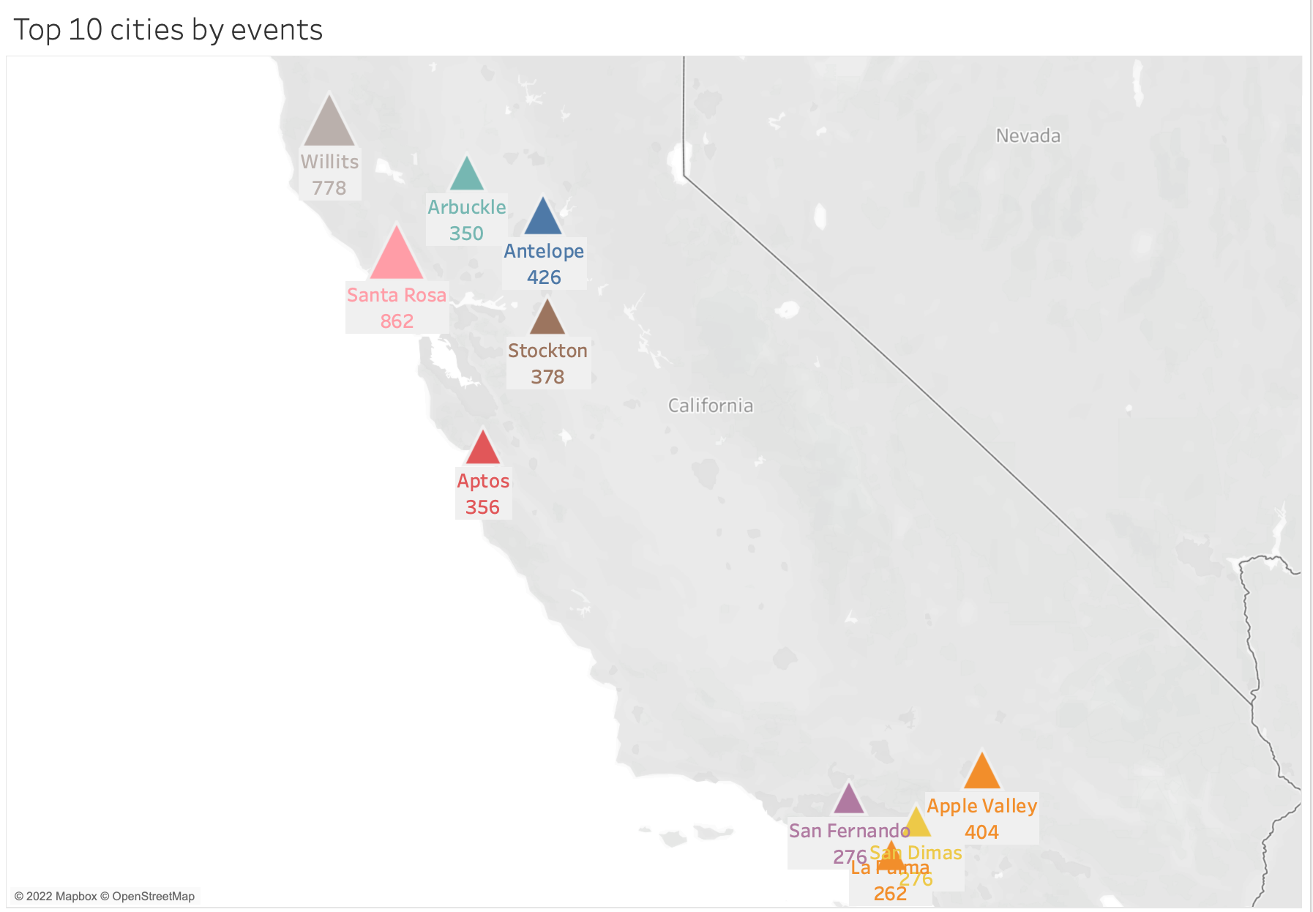
The top 10 cities based on the events are represented in the Visualization. Santa Rosa had the highest number of events(862) followed by Willits(778).

Slide 5
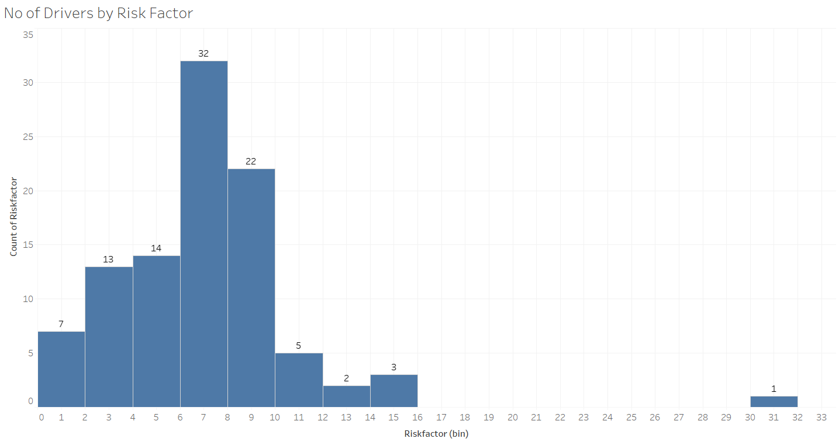
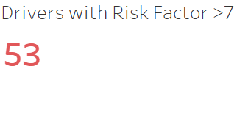
A total of 53 drivers have a risk factor > 7 who are considered risky drivers
More than 50% of drivers have a risk factor > 7

Slide 6
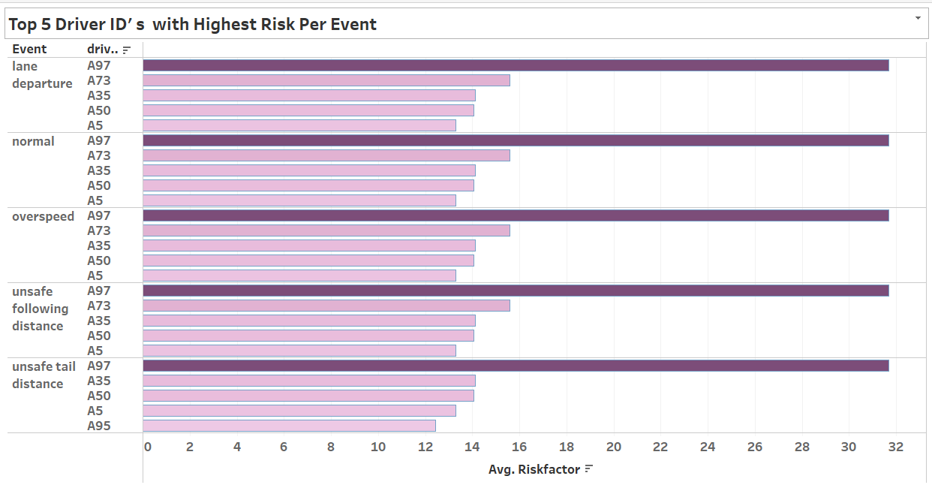
Top 5 Driver Id's with the highest risk are same across all the events
The five Id's are A97, A73, A35, A50, A5

Slide 7
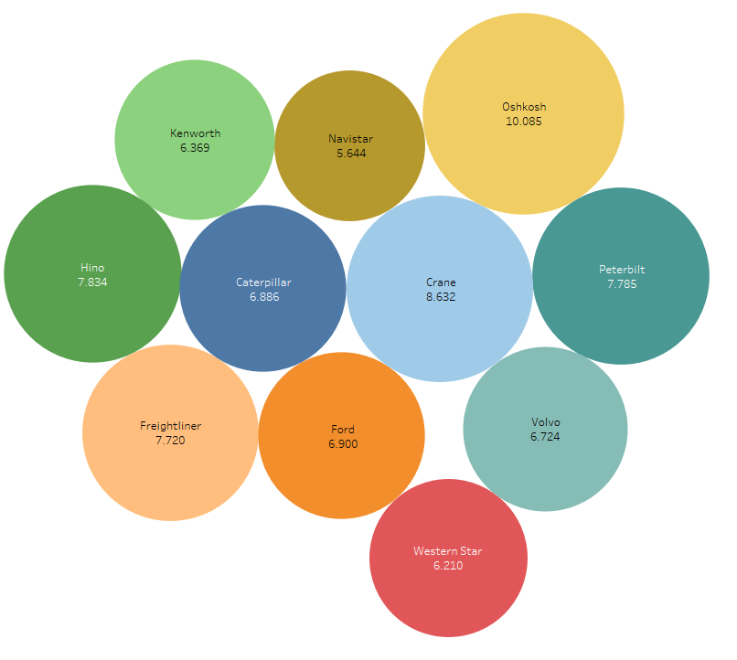
Model VS Risk Factor
Observation:
From the bubble chart we can conclude that Oshkosh, Crane and Hino are the models with highest risk factor
Recommendation:
Discontinuing the models with high risk factor like Oshkosh and Crane models

Slide 8
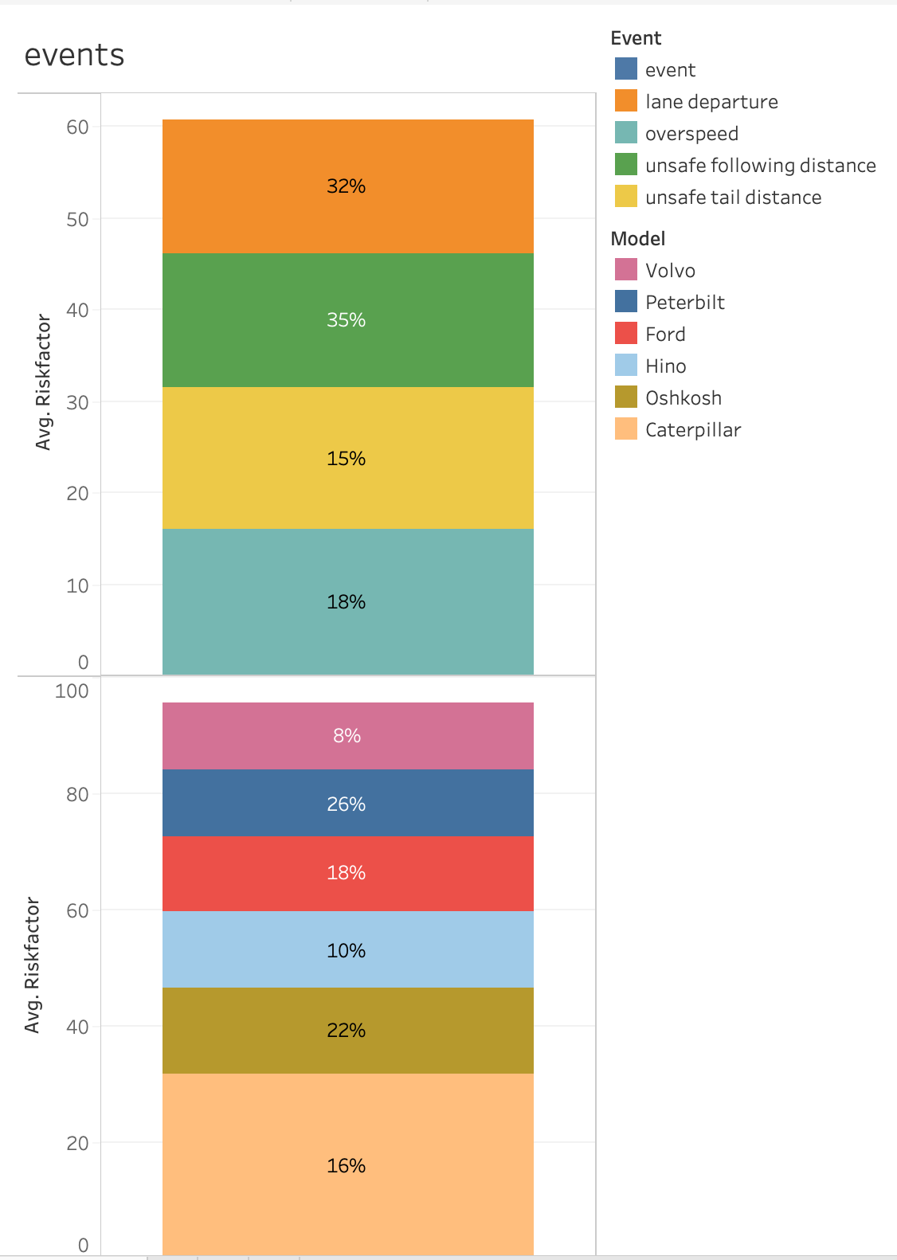
High-risk drivers are having high percentages of events for unsafe following distance events and for Peterbilt model trucks. So, drivers with high unsafe following distance events with Peterbilt model trucks may indicate risky.

Slide 9
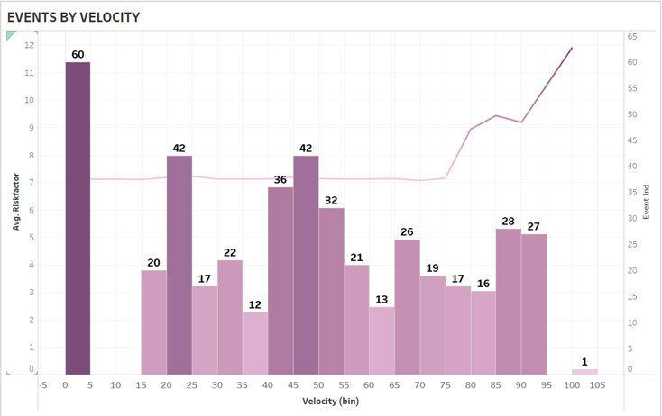
Alarming number of events for velocity < 5
Number of events are high when velocity is between 0-5
Velocity is not contributing considerably to risk factor

Slide 10
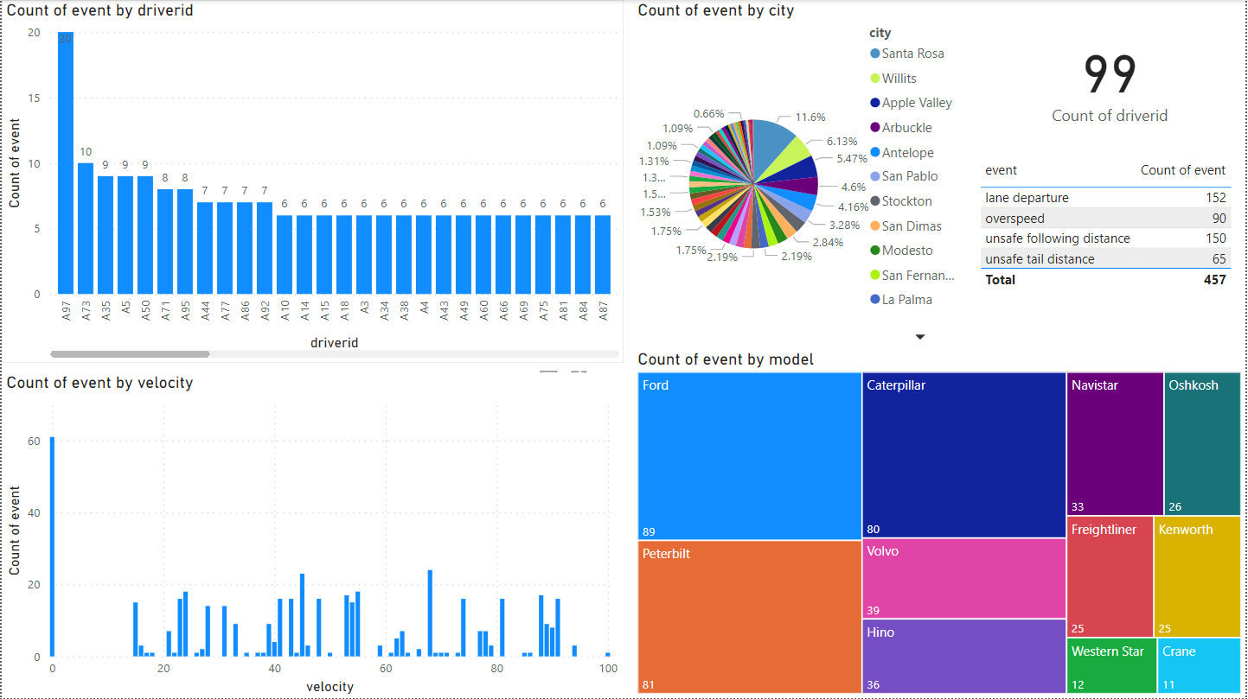
Events Dashboard

Slide 11
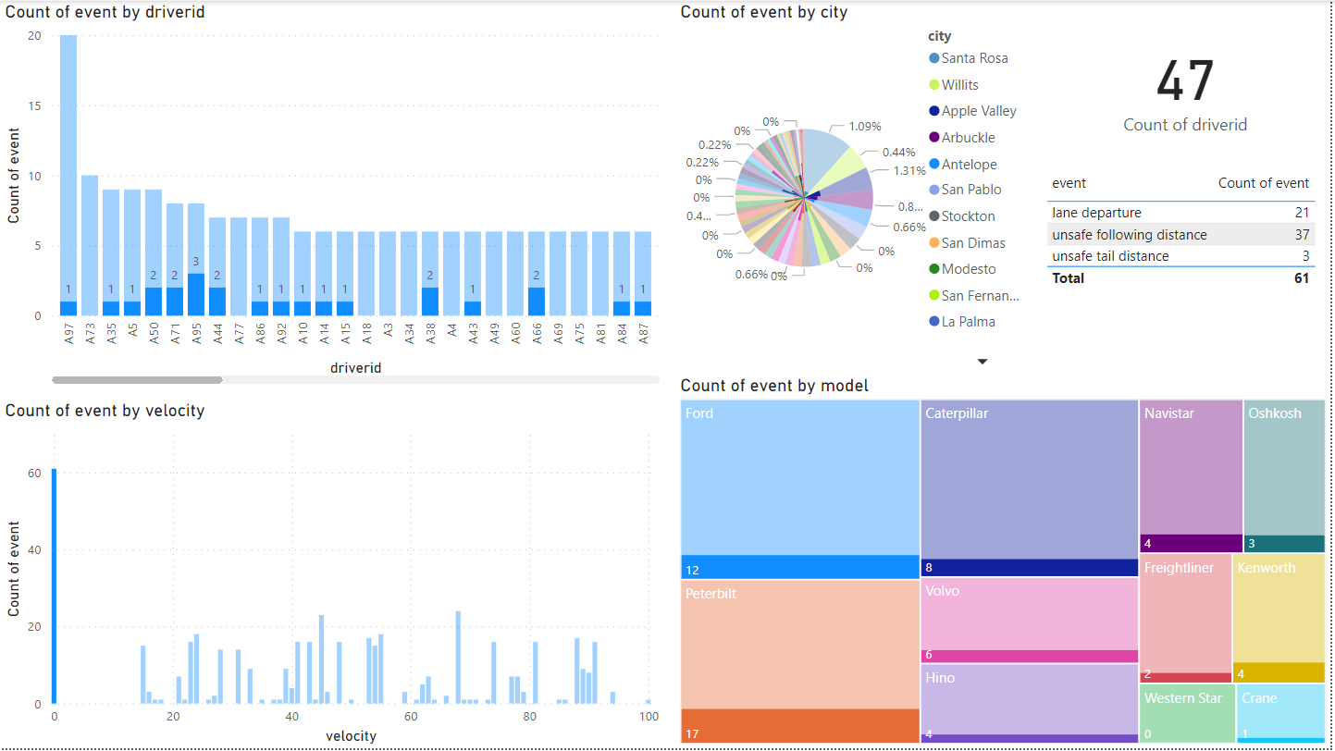
Events at zero velocity

Slide 12
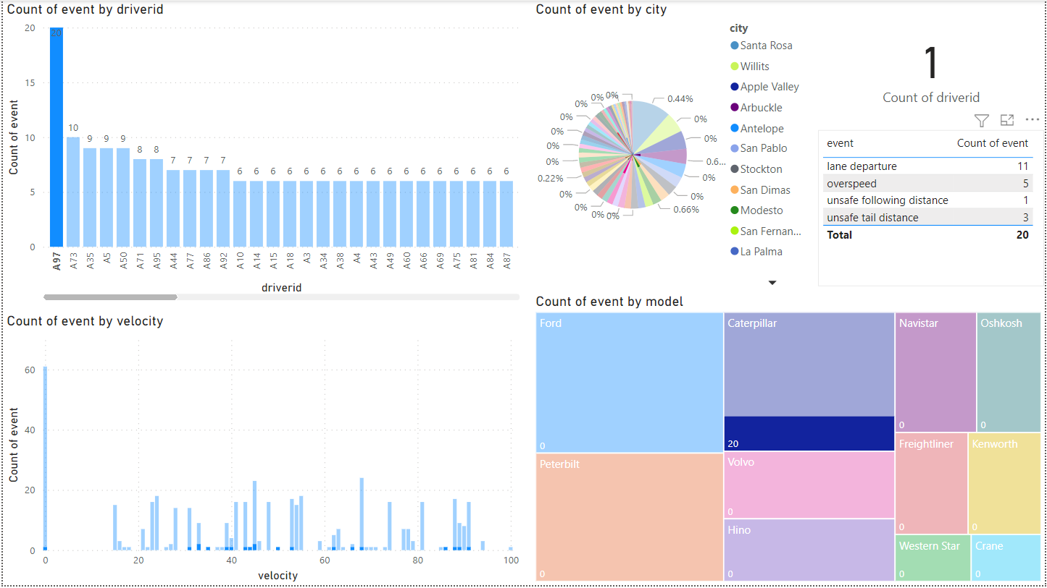
Riskiest driver based on events

Slide 13
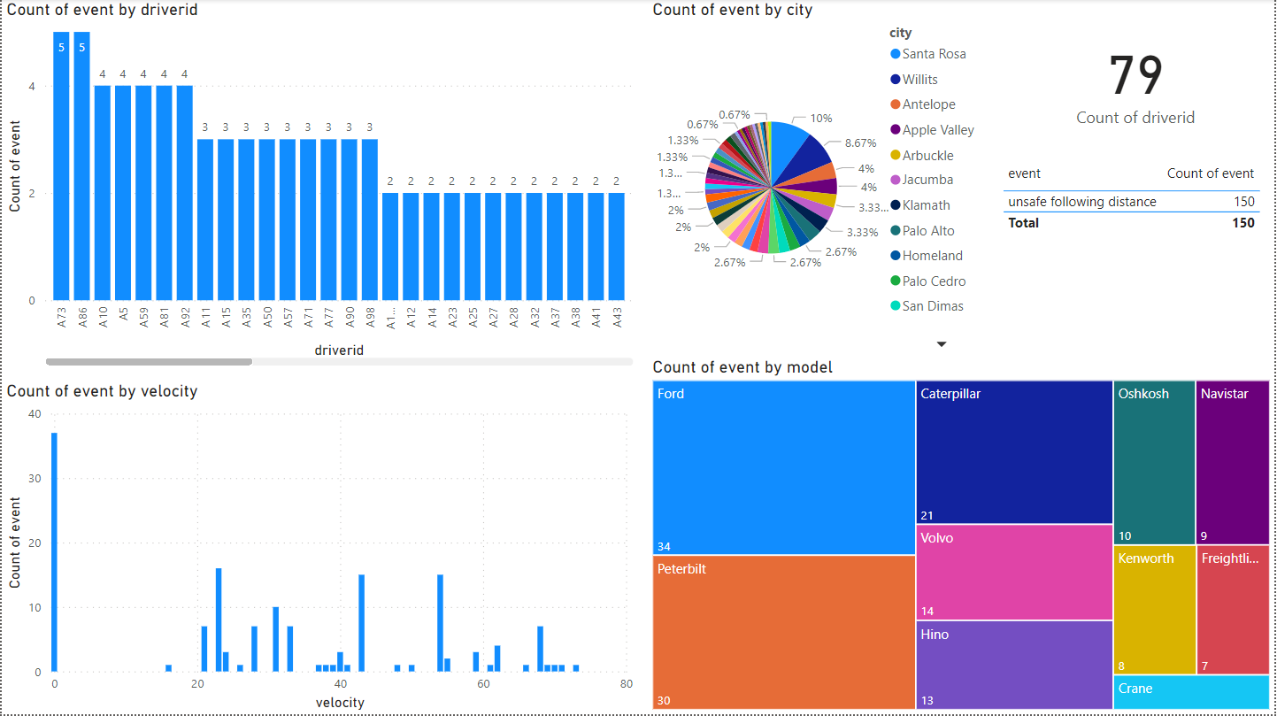
Individual Event Analysis

Slide 14
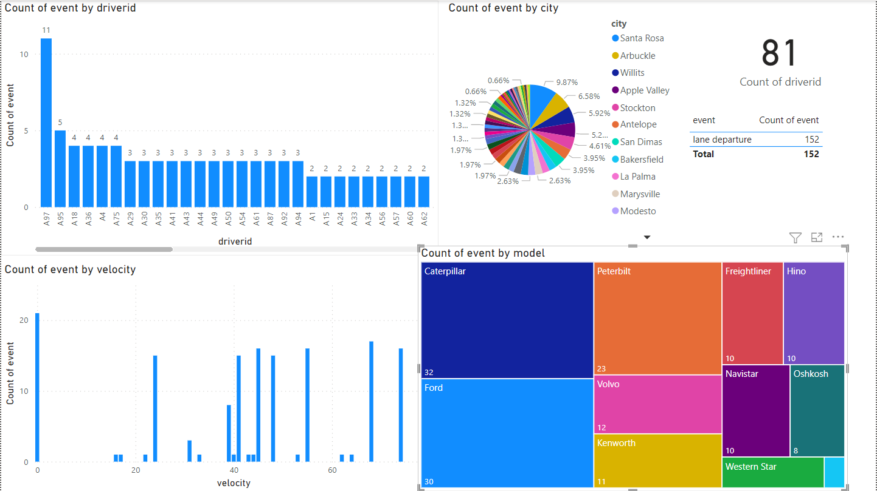

Slide 15
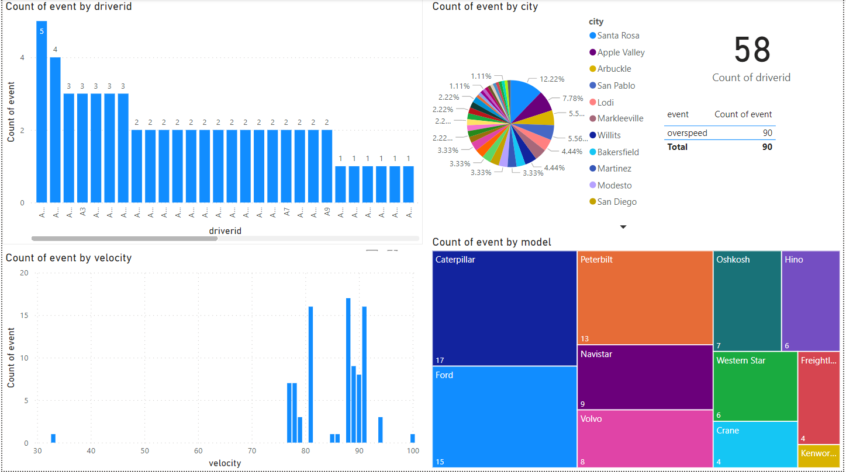

Slide 16
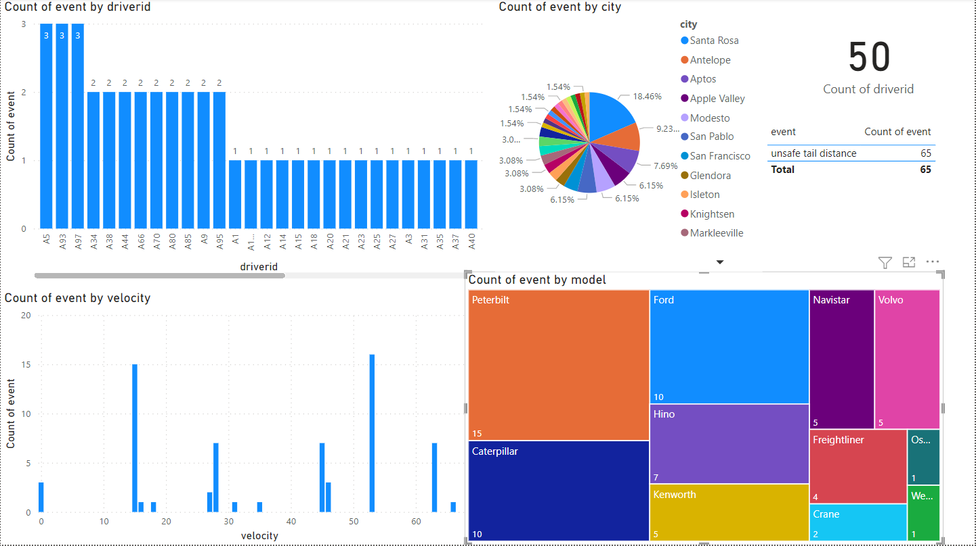

Slide 17
Conclusion
Santa Rosa had the highest number of events(862) and a total of 53 dangerous truck drivers
Based on the Top 10 risky drivers, we can conclude that drivers with Peterbilt model truck and high unsafe following distance events may indicate risky
Risk is high when number of events are more and risk factor is high for lane departure events(90.55%)
Risk factor is high for Oshkosh, Crane and Hino model trucks and discontinuing these models can mitigate the risk
Lane Departure and Unsafe following distance were among major reason for accidents with 152 and 150 records for each.
Ford, Peterbilt and Caterpillar recorded numbers of accidents with Crane and Western Star among the lowest number of event in California

